Slide 1
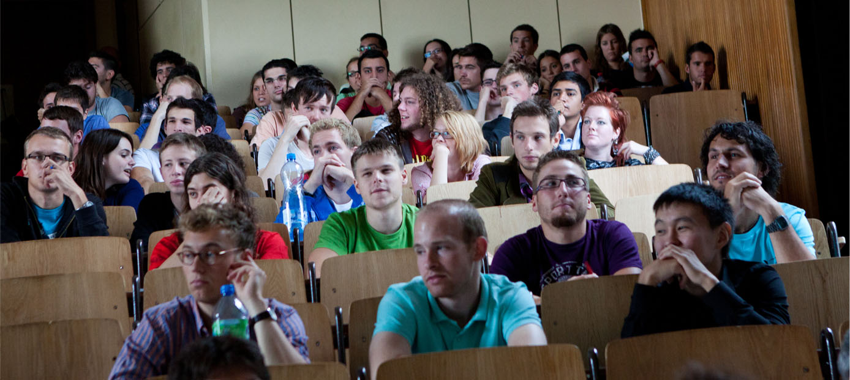
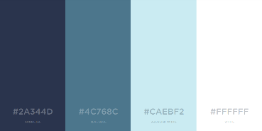

DESIGN USER INTERFACE
COMEL TEAM
2016 A
INFORMATICS LEARNING ENVIRONMENT
http://cs-learning.ml

Slide 2
SPRINT 1-3
S1
Do a user research with survey: http://bit.ly/DUICOMEL
S2
Make 2 alternative designs and do A/B testing: http://bit.ly/DUICOMEL2
S3
Make the prototype based on chosen design in Sprint 2.
Result: Sans Serif Font, Cool Color Palette
Result: Raleway Font, #2A344D #4C768C #CAEBF2 #FFFFFF Color Palette
Pages: Home, Dashboard, Course → still need to be edited

Slide 3
EXTENDED SPRINT 3
Remake prototype with Roshnilite theme
Set the Moodle:
Prepare the instruments
Install Moodle server on laptop
Start Moodle and access 127.0.0.1 in browser
Login as admin

Slide 4
EXTENDED SPRINT 3
Edit the Moodle theme:
Install Roshnilite theme plugin → Site Adm > Plugins > Install plugins
Activate the theme → Site Adm > Appearance > Themes > Theme selector
Change layout, font, color → Site Adm > Appearance > Themes > Roshnilite
Change CSS classes → Find all CSS and PHP files in Moodle folder > server > moodle > theme > roshnilite

Slide 5
DEPLOY IT!
http://cs-learning.ml
03
01
INSTALL
moodle
ON THE SITE
05
BUY DOMAIN IN freenom
02
04
EDIT MOODLE VIA
cpanel’s file manager
BUY
HOSTING
IN idcloudhost
EDIT MOODLE VIA
site adm

Slide 6
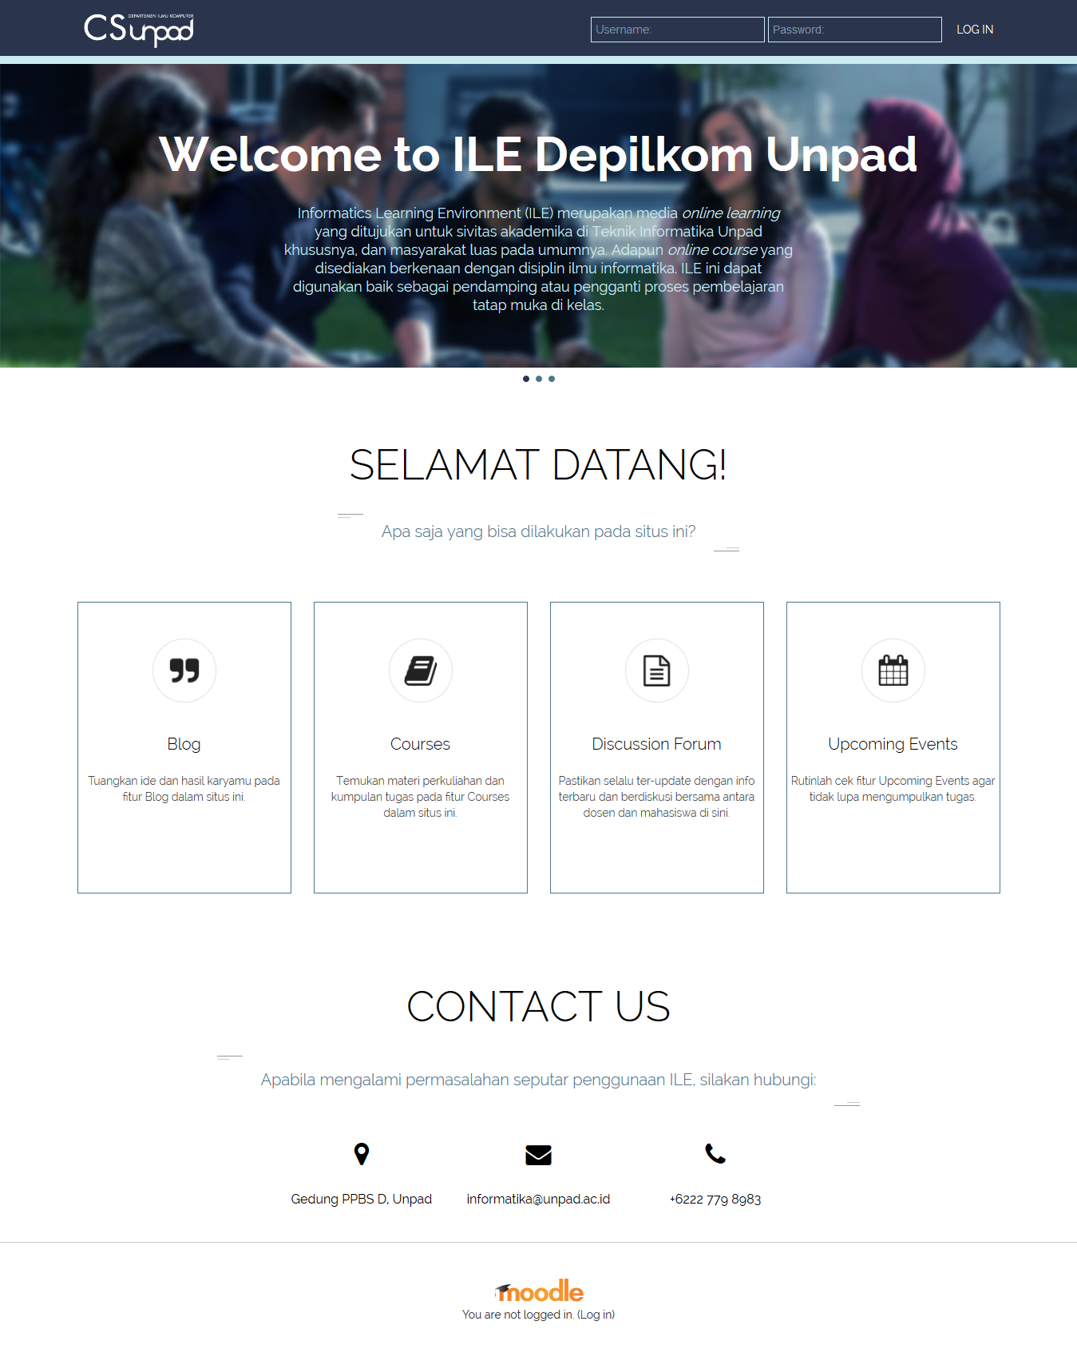
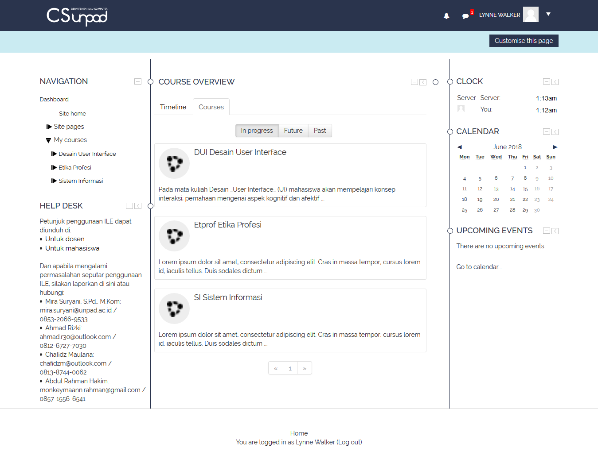
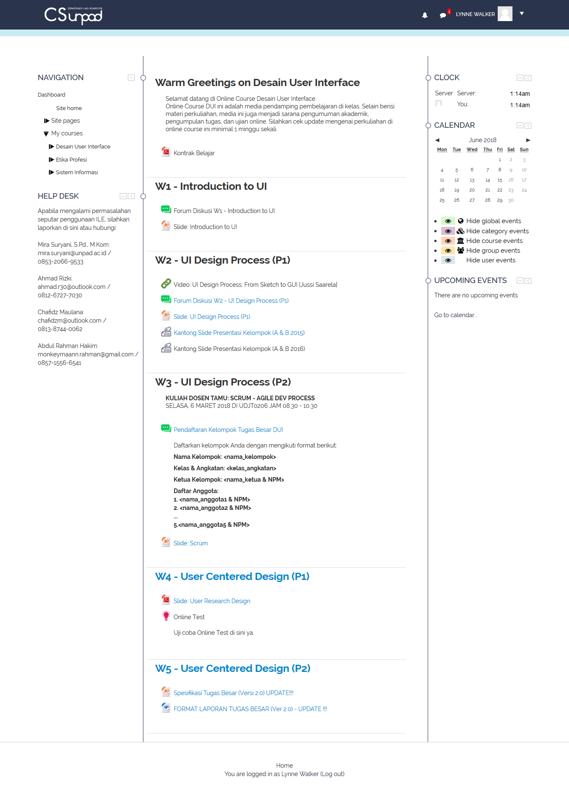
SCREENSHOTS

Slide 7
RESPONDENTS
Responden Usability Testing
Responden Heuristic Evaluation
NO. | NAMA | NPM | USIA | Jenis Kelamin
1 | Muhamad Yusrizan | 140810150041 | 22 | Laki-laki
2 | Shaleh Husen Attamimi | 140810160023 | 20 | Laki-laki
3 | Eko Fajar Putra | 140810160061 | 22 | Laki-laki
4 | Muhammad Fakhri Rahman | 140810170026 | 19 | Laki-laki
5 | Ghema Allan Ferdiansyah | 140810170048 | 19 | Laki-laki
NO. | Nama Lengkap | Usia | Jenis Kelamin | Durasi Pengalaman Menggunakan Moodle (tahun)
1 | Erick Paulus, S.Si., M.Kom. | 36 | Laki-laki | 3 tahun
2 | Mira Suryani, S. Pd., M.Kom. | 28 | Perempuan | 10 tahun
3 | Ahmad Rizki | 23 | Laki-laki | 2 tahun

Slide 8
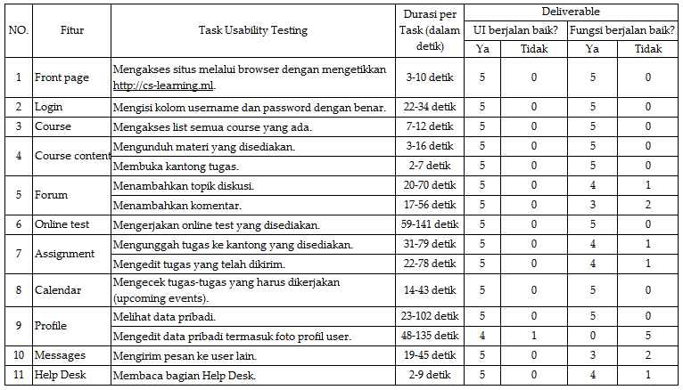
Usability Testing RESULT

Slide 10
Berapa tingkat kepuasan Anda terhadap UI Moodle yang dikembangkan dibandingkan dengan UI Moodle yang digunakan sekarang di ILE?
Berapa besar kemungkinan Anda ingin merekomendasikan situs UI Moodle ini kepada orang lain?

Slide 11
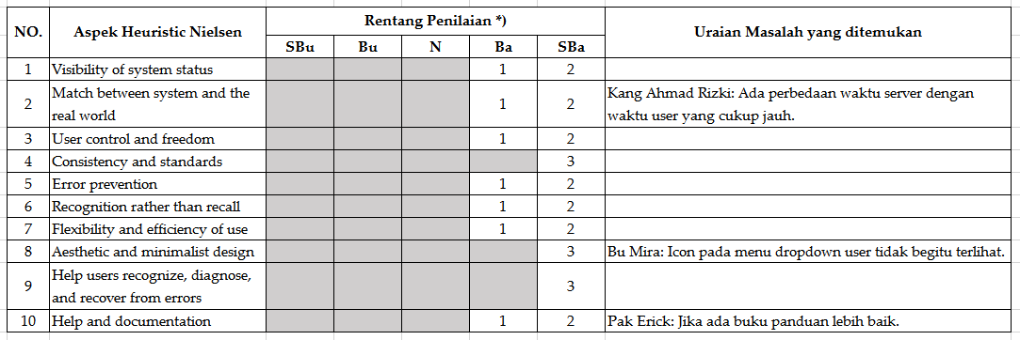
Heuristic Evaluation RESULT

Slide 12
Thank you ☺

